Slide 1

Introduction to AI for Climate Research
Fiona Spuler, University of Reading
SPARC Training School ‘Climate Data Analysis and AI in the Global South’
October 31st, 2023
Notes:
1

Slide 2


Personal introduction
Fiona Spuler - PhD researcher at the University of Reading, jointly supervised between Meteorology and Computer Science departments as well as ECMWF
Research topic: combining generative ML methods with physical process understanding to improve S2S forecasts
Other work: co-developed open-source Python package ibicus for bias adjustment of climate models, in particular method comparison and evaluation
Background: MSc Mathematical Physics, MSc Environmental Change and Management
Contact:
f.r.spuler@pgr.reading.ac.uk

Slide 3
Structure of the lecture
Introduction: what is the difference between AI, machine learning and statistics?
Overview of machine learning methods and applications in climate and weather science
Open questions in machine learning: interpretability, uncertainty, physical consistency, treatment of extremes and causality
Application study: clustering using variational autoencoders

Slide 4
Structure of the lecture - part 1
Introduction: what is the difference between AI, machine learning and statistics?
Overview of machine learning methods and applications in climate and weather science
Open questions in machine learning: interpretability, uncertainty, physical consistency, treatment of extremes and causality
Application study: clustering using variational autoencoders

Slide 5

Machine Learning vs Statistics vs AI
So is machine learning just glorified statistics?
Source: https://www.instagram.com/sandserifcomics/

Slide 6
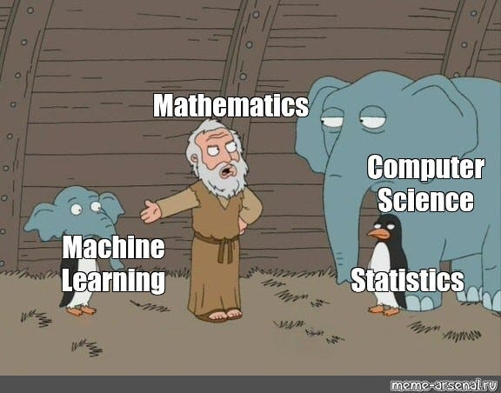
Machine Learning vs Statistics vs AI
... or a hybrid of statistics and computer science forged by mathematics?

Slide 7
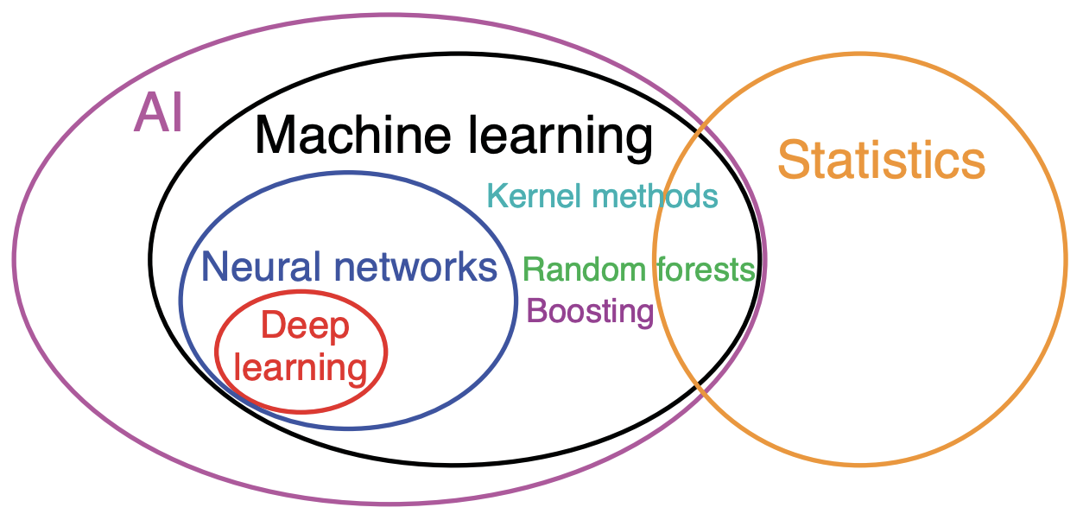
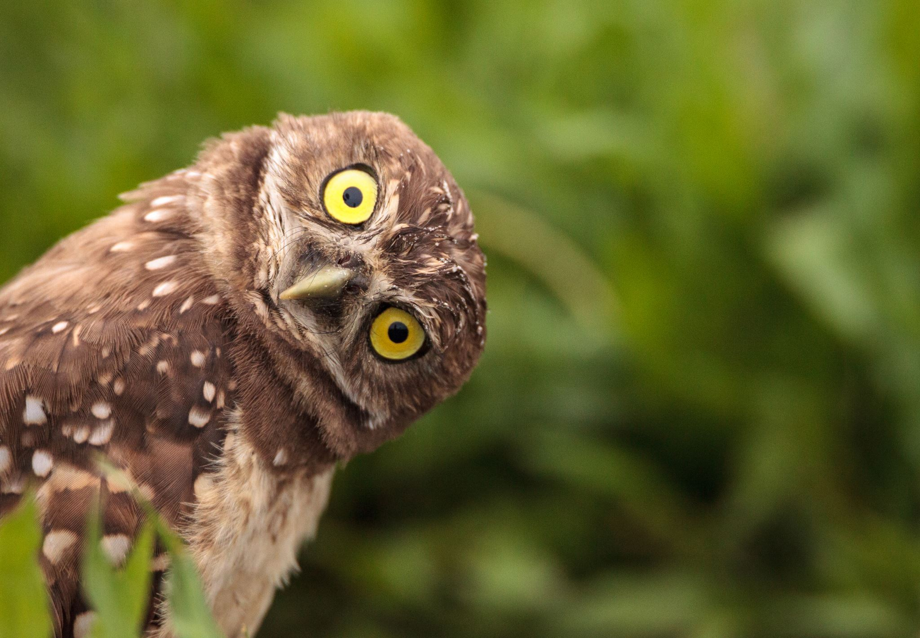

Machine Learning vs Statistics vs AI
... or
Hsieh (2022)

Slide 8


Overview: statistics
Emerged from mathematics
Aim: quantify relationships between variables, model uncertainty, extract information from small samples
Uses probability theory and assumptions about data generation process to develop theory underlying model design
Requires careful understanding of underlying data and assumptions.
Often limited to linear models due to small sample sizes
‘Statistical Modeling: the two cultures’ (Breiman 2001): algorithmic vs theoretical approach
Spread across many disciplines: biostatistics, statistics for finance etc

Slide 9


Overview: machine learning
Emerged from computer science and motivation to develop artificial intelligence which shaped initial application areas: image and speech recognition, text generation etc.
Inspiration of neural networks in neuroscience and human brain
Algorithmic learning on larger datasets, focus on prediction accuracy, less emphasis on assumptions and uncertainty
Emergent behavior in deep learning methods and loss of traceability of model performance
Importance of computing capacity and large datasets -> success of private actors such as Google, Microsoft, Nvidia etc
Focus on performance against benchmarking methods on standardized tasks (for example MNIST dataset) and publication at conferences rather than in journals

Slide 10




Statistics
vs
Machine Learning
-> Two fields with similar goals and tools but different motivations and approaches.

Slide 11
Statistics
and
Machine Learning
Examples:
Variational autoencoders are a deep learning methods that build on Bayesian variational inference (a statistical method) fitted through a neural network encoder and decoder (machine learning architecture) (Kingma et al 2013)
Combining generative models (deep learning method) with extreme value theory (statistical theory) to improve representation of extremes in ML method (Boulaguiem et al 2022)

Slide 12
Why is machine learning useful?
Can leverage large datasets (of which we have increasing amounts) and large computing capacity (which is growing every year)
Ability to fit highly complex, non-linear functions to data through (deep) neural network architecture
Improved performance compared to statistical method in prediction tasks
Good performance in tasks that ‘traditional’ statistics never tackled such as image recognition, text generation etc
However: outstanding issues remain (discussed later in the lecture) on not a universal remedy to any scientific problem!

Slide 13
Artificial Intelligence
Often used when talking about machine learning
Reflects broader aim to develop artificial intelligence and inspiration by human brain
Can often be seen as pretentious when talking about very simple machine learning methods (such as k-means clustering) – but just use as appropriate

Slide 14
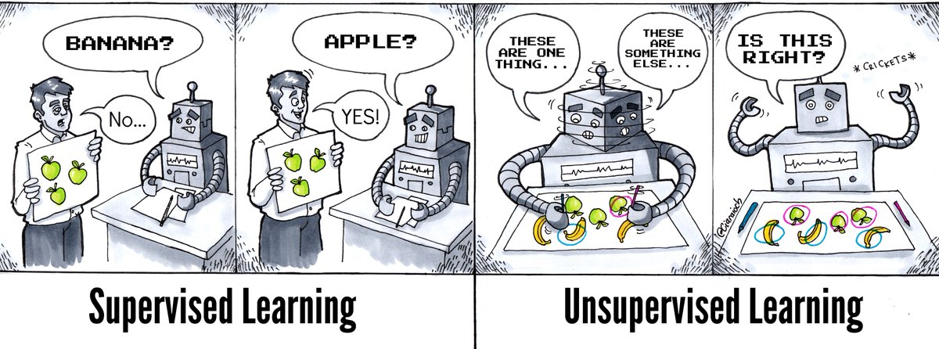
Machine learning methods
High-level distinction between supervised (labeled training data), unsupervised (no labels for training data), semi-supervised (some labels for training data) and reinforcement (feedback to performance) learning
https://twitter.com/athena_schools/status/1063013435779223553

Slide 15
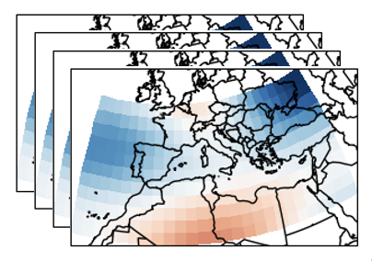
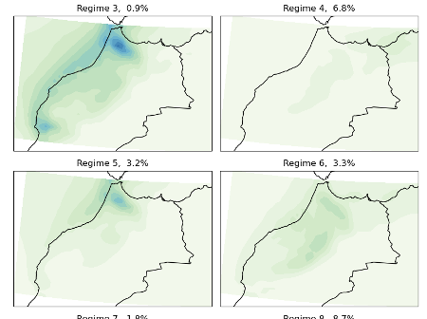
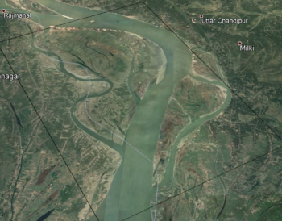
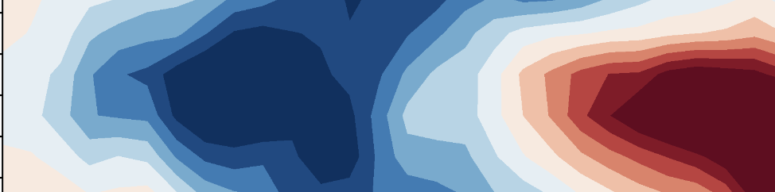

Machine learning methods
Unsupervised learning – Dimensionality reduction
Unsupervised learning – clustering
Can we represent this high-dimensional space in a reduced number of dimensions?
Can we group similar spatial patterns of precipitation over this region?
Supervised learning – classification
Supervised learning – regression
Can we classify the types of land cover in this satellite dataset?
Can we predict the El-Niño Southern Oscillation in 18 months?

Slide 16
Machine learning methods
Unsupervised learning – Dimensionality reduction
Unsupervised learning – clustering
Linear: principal component analysis (PCA), canonical correlation analysis (CCA)
Nonlinear: Autoencoders, factor analysis
Nonlinear and probabilistic: Generative methods such as variational autoencoders (VAEs) or generative adversarial networks (GANs)
K-means clustering, hierarchical clustering
Hidden Markov Models (HMMs) to incorporate temporal information
Gaussian mixture models for probabilistic clustering
Supervised learning – classification and regression
Support Vector Machines
Decision Trees (Random Forests, XGBoost)
Neural networks (Multilayer Perceptron)
Convolutional Neural Networks (CNN) for image analysis
Recurrent Neural Networks (RNNs), Long Short-Term Memory (LSTM), Transformer architectures to

Slide 17
Application of machine learning in climate science
High-performance computing and data processing infrastructure
Observations
Data assimilation
Weather / S2S Forecast
Post-processing
Impact modelling
Reanalysis
Climate models
Adapted from ECMWF MOOC

Slide 18
Application of machine learning in climate science
Deep learning to improve data assimilation (Laloyaux et al 2022)
Weather Forecasting using ML models (Bi et al 2023)
Calibrating dynamical forecasts using machine learning for improved sub-seasonal forecasts (Vitart et al 2022)
High-performance computing and data processing infrastructure
Observations
Data assimilation
Weather / S2S Forecast
Post-processing
Impact modelling
Reanalysis
Climate models
Process satellite observations through land cover classification (Talukdar et al 2020)
Downscaling climate models using machine learning (Harris et al. 2022)
Emulating model components such as sea ice modelling (Jouvet et al. 2023)
(Hybrid) machine learning for crop modelling (Shahhosseini et al 2021)
Adapted from ECMWF MOOC

Slide 19
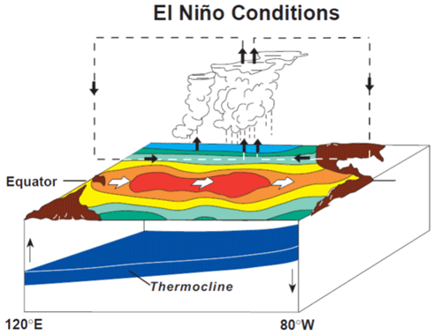
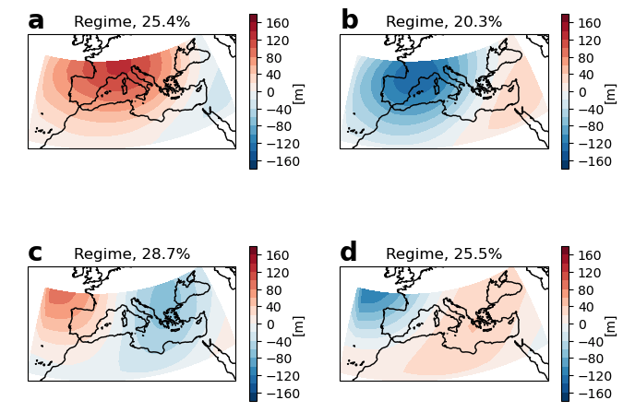
Two simple examples
1. Predicting the El-Niño Southern Oscillation (tutorial)
2. Clustering weather regimes in the Mediterranean region (optional)
Task: Prediction of ENSO index using decision trees and random forest
Keywords: supervised learning, classification, feature importance
Task: Clustering wintertime geopotential anomalies using the kmeans algorithm and investigating associated extreme precipitation
Keywords: unsupervised learning, kmeans clustering, weather regimes

Slide 20
Structure of the lecture – part 2
Introduction: what is the difference between AI, machine learning and statistics?
Overview of machine learning methods and applications in climate and weather science
Open questions in machine learning: interpretability, uncertainty, physical consistency, treatment of extremes and causality
Application study: clustering using variational autoencoders

Slide 21
Open questions in machine learning
(focus: machine learning applied to climate and weather science)
Explainability and interpretability of model output – XAI (Explainable Machine Learning)
Physics-informed machine learning
Other issues that we will not cover today:
Uncertainty quantification, unbalanced data
Treatment of extremes or other situations where sampled data is sparse
Causality

Slide 22
Explainable/interpretable machine learning
Motivation: many deep learning methods are not easily interpretable or explainable. Explainable or interpretable AI methods (XAI) aim to uncover the the reasons behind the predictions of a network.
Three types of interpretable ML methods (based on Molnar et al 2020)
Directly analyse model components: Feature maps of CNNs, for random forests analyse Gini importance and minimal depth distribution.
Study sensitivity of model to input perturbations: Distinction between local explanations (Shapley values and counterfactual explanations which explain predictions in form of what-if scenarios + some model-specific methods) and global explanations (distinction between feature importance (permutation effect, removing features and retraining etc) and feature effect (partial dependence plots etc)
Analyse local or global surrogate approximations of ML model - designed to 'copy' the behaviour of the ML model
For an overview of XAI methods and their application to climate science, see Bommer et al (2022, pre-print)

Slide 23
Physics-informed machine learning
Motivation: we know a lot about the physics of our climate system. Machine learning methods should at the least be physically consistent (respect things such as the conservation of mass) and possibly even be able to leverage our physical understanding for better predictions.
Approaches:
Physics-based regularization: penalize divergence from laws of physics in the loss function
Customized architectures to enforce physical constraints (spherical CNN)
Leverage known symmetries or invariances
Embed multi-scale properties as statistical constraints (for example, Wu et al 2020 capture the scale distribution and correlations across scales in a GAN model of turbulent convection by enforcing covariance constraints)
Architectures that ensure spatio-temporal consistency
For an excellent overview of physics-informed machine learning methods for weather and climate science, see Kashinath et al 2020

Slide 24
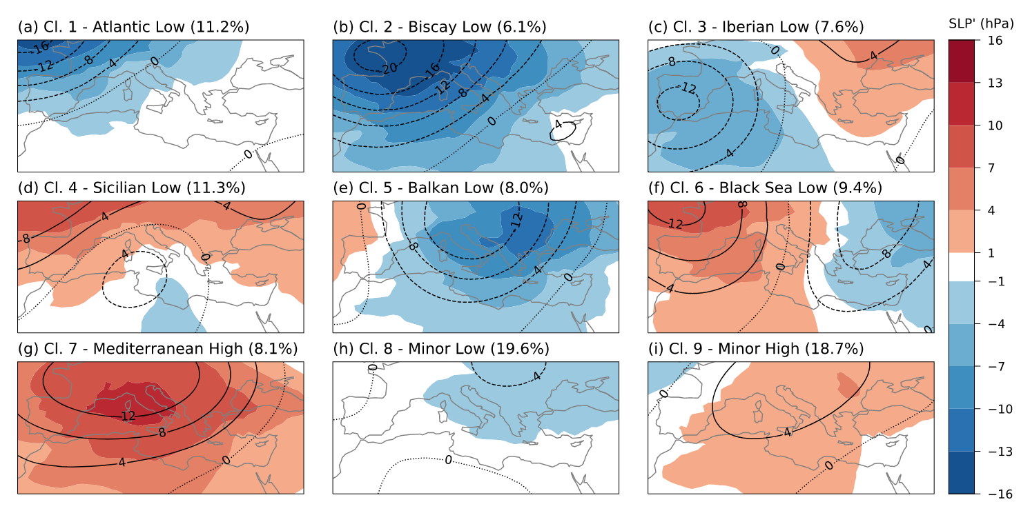
Advances method in application: Using variational autoencoders to identify patterns in large-scale circulation
Mastrantonas et al 2020

Slide 25
Motivation
In many regions, atmospheric dynamics can be characterized by a finite number of recurring and persistent patterns, so-called weather regimes.
Weather regimes can be useful for applications such as downscaling of climate models or extended-range forecasting, because they can capture large-scale patterns associated with extremes but provide extended range predictability at the same time
Standard procedure to identify weather regimes
Dimensionality reduction: Apply PCA (EOF) analysis to z500 geopotential height or MSLP field
Cluster the dimensionality reduced data using k-means clustering

Slide 26
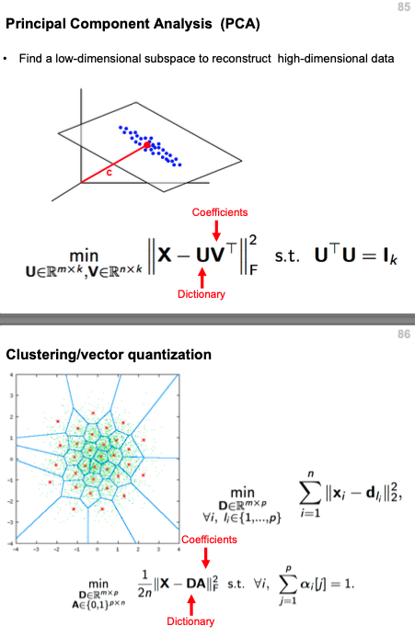
Background: PCA/EOF analysis and k-means clustering
K-means
Introduction to Machine Learning, UCL 2020

Slide 27
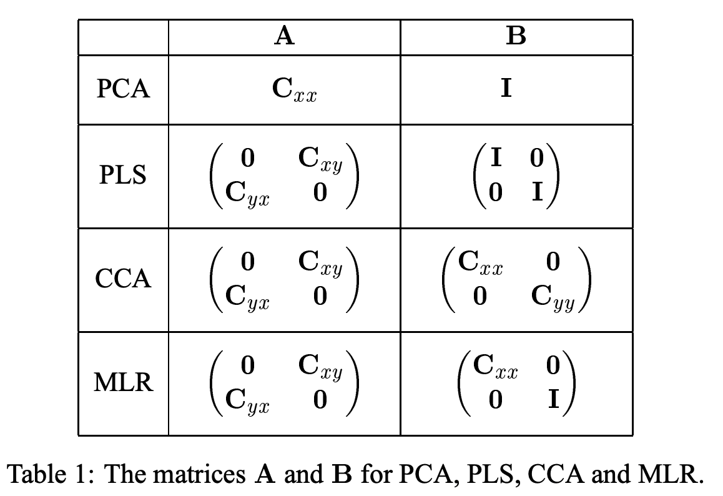
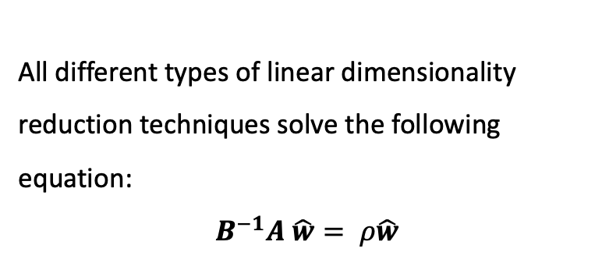
Linear dimensionality reduction
All different types of linear dimensionality reduction techniques solve the following equation:
$$B^{−1}A \hat{w}= ρ\hat{w}$$

Slide 28
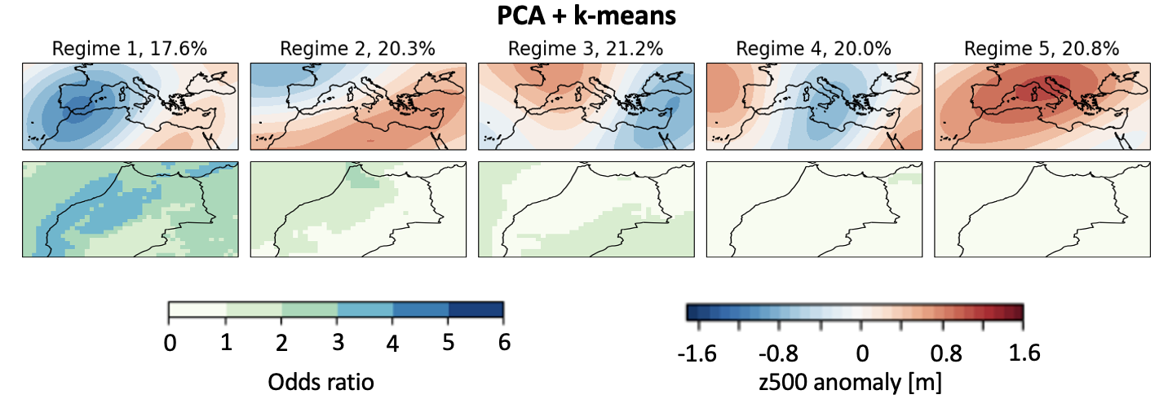
Clusters of atmospheric circulation based on PCA + k-means
Two issues with this approach:
PCA is a linear and non-probabilistic dimensionality reduction method
The method is not specific to the target variable

Slide 29
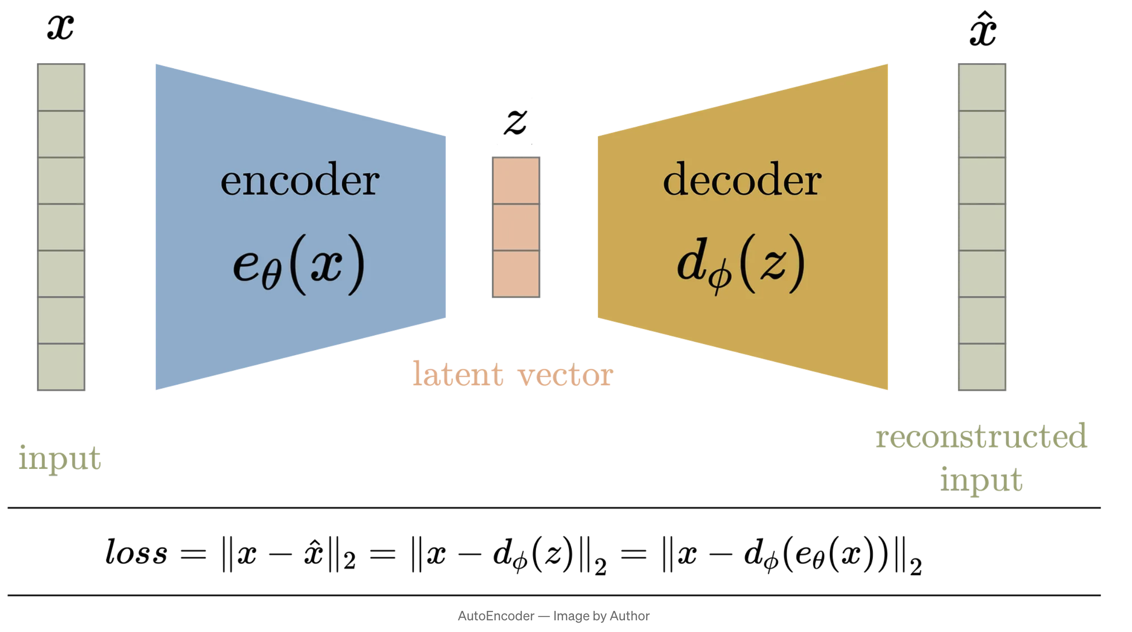
Background - Autoencoders
PCA analysis can be thought of in terms of learning an encoder (into the reduced space) and a decoder (out of the reduced space).
An autoencoder is a nonlinear generalization of this idea, implemented through a neural network
Loss function is simply the reconstruction loss
If the neural network has one linear layer, the autoencoder can converge to the PCA solution when minimizing certain types of reconstruction loss.
An autoencoder is ‘strictly more powerful than PCA’ meaning it encodes more information per latent dimension
https://towardsdatascience.com/understanding-variational-autoencoders-vaes-f70510919f73
However, the latent space is not regularized and therefore not continuous which is unfortunate for clustering

Slide 30
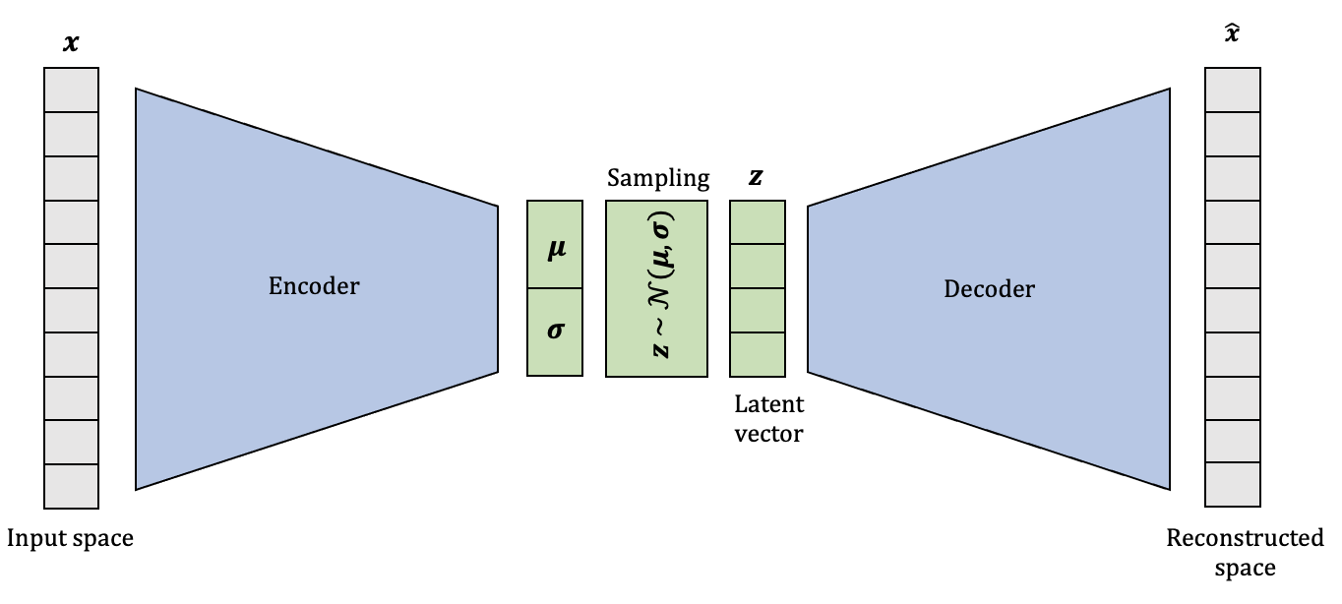
Background - Variational Autoencoders
Architecture similar but mathematical derivation different from Autoencoder
Variational Bayesian Method (loss function derived by finding an approximation to the likelihood using the Evidence Lower Bound)
Regularizes the latent space by explicitly modelling a (most often Gaussian) distribution
Why work with a variational autoencoder?
Method based on Bayesian Variational Inference that allows us to incorporate priors and covariates (i.e. the target variable) and integrate dimensionality reduction with probabilistic clustering
Nonlinear dimensionality reduction could provide improved latent space

Slide 31
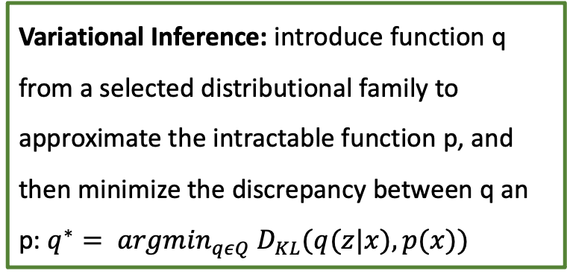
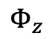

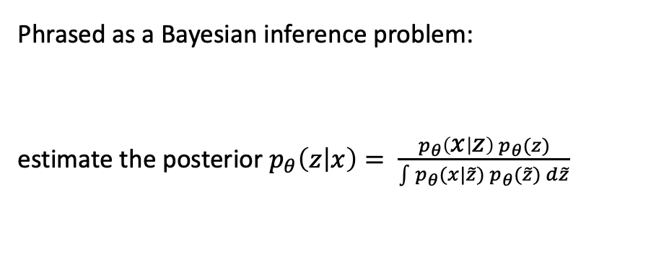

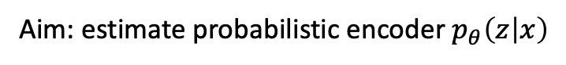

Background – Variational Inference
Starting point:
However, computing the marginal likelihood is computationally intractable.
$$Φ_{z}$$
z
Latent space
Inference model
Generative model
$$θ$$
x
Original space
Variational Inference: introduce function q from a selected distributional family to approximate the intractable function p, and then minimize the discrepancy between q an p: $q^{∗}= {argmin}_{qεQ} D_{KL}(q(z|x), p(x))$
Aim: estimate probabilistic encoder $p_{θ}\left(z | x\right)$
Phrased as a Bayesian inference problem:
estimate the posterior $p_{θ}\left(z | x\right)= \frac{p_{θ}\left(x | z\right){ p}_{θ}(z)}{\int{p_{θ}(x|}\tilde{z}) p_{θ}(\tilde{z}) d\tilde{z}}$
Likelihood $p_{θ}\left(x | z\right)\sim N\left(x;f\left(z, θ\right), σ^{2}1\right)$
Prior $p_{θ}\left(z\right)\sim N\left(0, 1\right)$

Slide 32
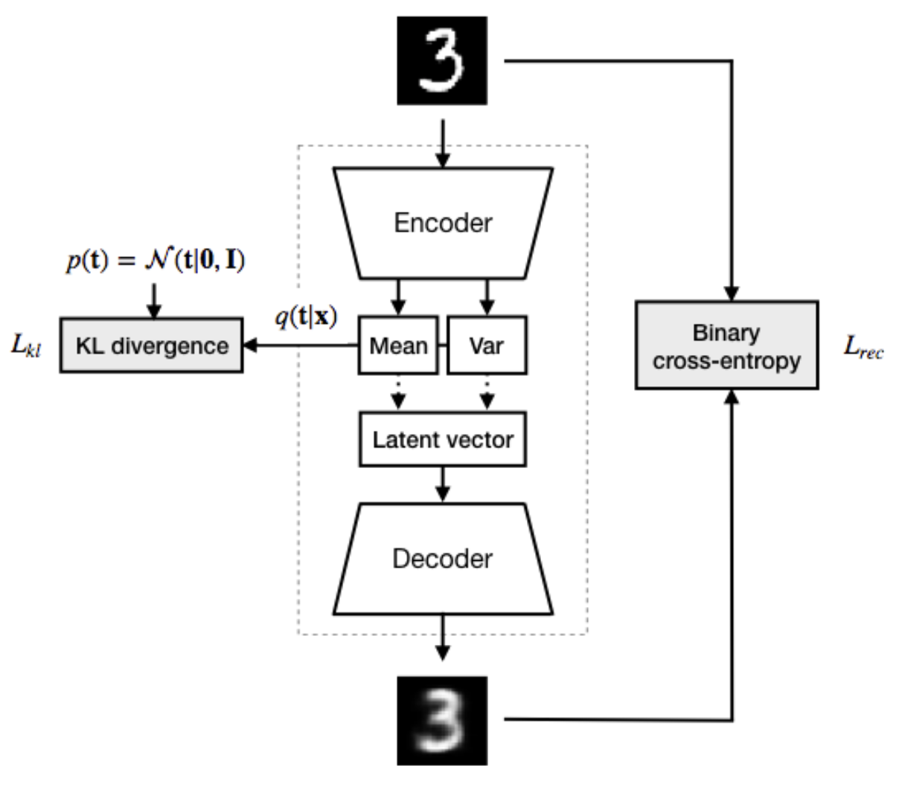
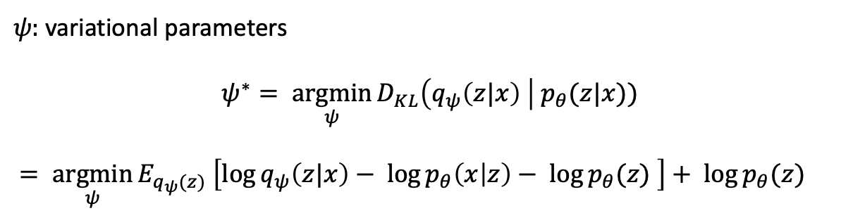
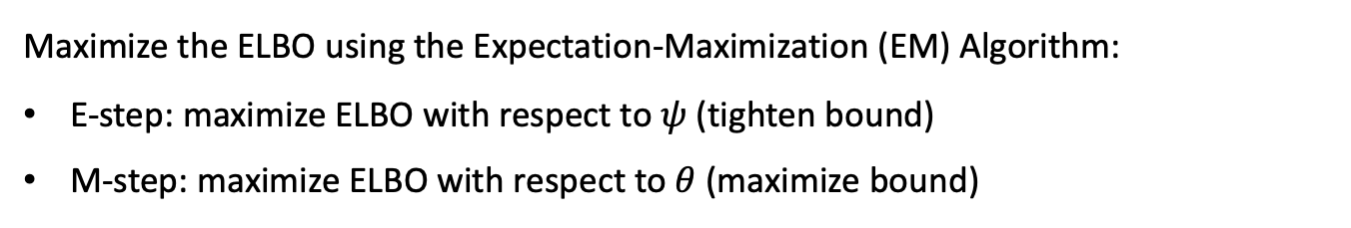
Background - VAE loss function
$ψ:$variational parameters
$$ψ^{∗}= \underset{ψ}{argmin}{D_{KL}\left(q_{ψ}\left(z|x\right) \right| p_{θ}(z|x)) }$$
$= \underset{ψ}{argmin}{E_{q_{ψ}(z)} \left[\log{q_{ψ}\left(z|x\right)− \log{p_{θ}\left(x | z\right)− \log{p_{θ}(z)} }}\right]+ \log{p_{θ}(z)}}$
Evidence Lower Bound (ELBO) $ℒ\left(θ, ψ \right| x)=E_{q_{ψ}(z|x)} \left[\log{p_{θ}\left(x | z\right)}\right]$ - $D_{KL}\left(q_{ψ}\left(z|x\right) \right| p_{θ}(z))$
Reconstruction loss
KL divergence from prior
Maximize the ELBO using the Expectation-Maximization (EM) Algorithm:
E-step: maximize ELBO with respect to $ψ$ (tighten bound)
M-step: maximize ELBO with respect to $θ$ (maximize bound)

Slide 33
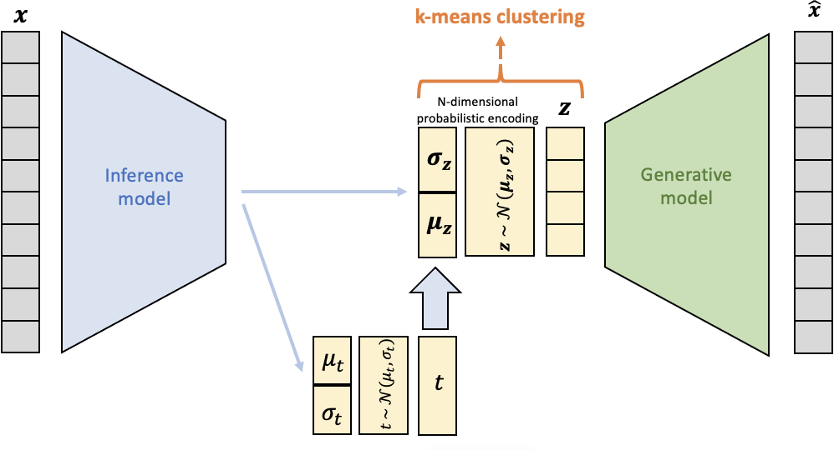
A modified VAE architecture for targeted clustering

Slide 34
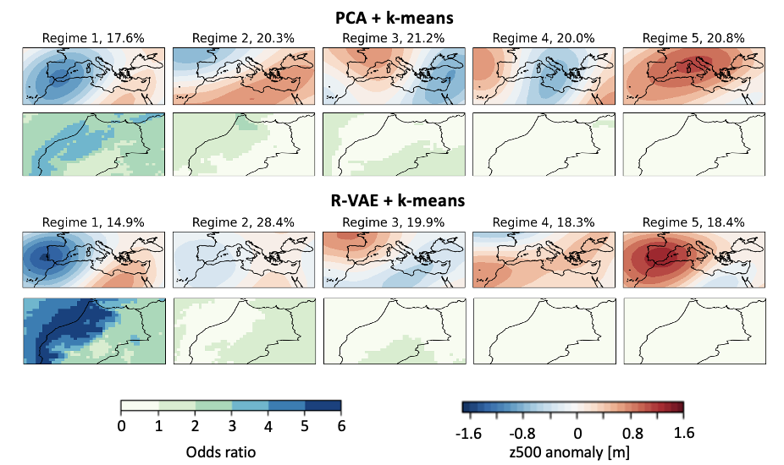
Results

Slide 35
Machine Learning – free learning resources
ECMWF Massive Open Online Course (MOOC) on Machine Learning in Weather & Climate (https://lms.ecmwf.int/pages/index.html)
Murphy 2022, 2023: Probabilistic Machine Learning – an excellent resource if you want more in-depth knowledge about a specific method! https://probml.github.io/pml-book/book1.html

Slide 36
Tutorial
Follow this link to the google colab notebook!
http://bit.ly/SPARC_Training

Slide 37
References
Talukdar, S.; Singha, P.; Mahato, S.; Shahfahad; Pal, S.; Liou, Y.-A.; Rahman, A. Land-Use Land-Cover Classification by Machine Learning Classifiers for Satellite Observations—A Review. Remote Sens. 2020, 12, 1135. https://doi.org/10.3390/rs12071135
Shahhosseini, M., Hu, G., Huber, I. et al. Coupling machine learning and crop modeling improves crop yield prediction in the US Corn Belt. Sci Rep 11, 1606 (2021). https://doi.org/10.1038/s41598-020-80820-1
Jouvet, G., & Cordonnier, G. (2023). Ice-flow model emulator based on physics-informed deep learning. Journal of Glaciology, 1-15. doi:10.1017/jog.2023.73
Neelesh Rampal, Peter B. Gibson, Abha Sood, Stephen Stuart, Nicolas C. Fauchereau, Chris Brandolino, Ben Noll, Tristan Meyers, High-resolution downscaling with interpretable deep learning: Rainfall extremes over New Zealand, Weather and Climate Extremes, Volume 38, 2022, 100525, ISSN 2212-0947, https://doi.org/10.1016/j.wace.2022.100525.
Bi, K., Xie, L., Zhang, H. et al. Accurate medium-range global weather forecasting with 3D neural networks. Nature 619, 533–538 (2023). https://doi.org/10.1038/s41586-023-06185-3
Laloyaux, P., Kurth, T., Dueben, P. D., & Hall, D. (2022). Deep Learning to Estimate Model Biases in an Operational NWP Assimilation System. Journal of Advances in Modeling Earth Systems, 14(6), e2022MS003016. https://doi.org/10.1029/2022MS003016
Vitart, F., Robertson, A. W., Spring, A., Pinault, F., Roškar, R., Cao, W., Bech, S., Bienkowski, A., Caltabiano, N., Coning, E. D., Denis, B., Dirkson, A., Dramsch, J., Dueben, P., Gierschendorf, J., Kim, H. S., Nowak, K., Landry, D., Lledó, L., … Zhou, S. (2022). Outcomes of the WMO Prize Challenge to Improve Subseasonal to Seasonal Predictions Using Artificial Intelligence. Bulletin of the American Meteorological Society, 103(12), E2878–E2886. https://doi.org/10.1175/BAMS-D-22-0046.1
Kashinath K., Mustafa M., Albert A., Wu J-L., Jiang C., Esmaeilzadeh S., Azizzadenesheli K., Wang R., Chattopadhyay A., Singh A., Manepalli A., Chirila D., Yu R., Walters R., White B., Xiao H., Tchelepi H. A., Marcus P., Anandkumar A., Hassanzadeh P. and Prabhat 2021Physics-informed machine learning: case studies for weather and climate modellingPhil. Trans. R. Soc. A.3792020009320200093 http://doi.org/10.1098/rsta.2020.0093
Molnar, C., Casalicchio, G., & Bischl, B. (2020). Interpretable Machine Learning – A Brief History, State-of-the-Art and Challenges. In I. Koprinska, M. Kamp, A. Appice, C. Loglisci, L. Antonie, A. Zimmermann, R. Guidotti, Ö. Özgöbek, R. P. Ribeiro, R. Gavaldà, J. Gama, L. Adilova, Y. Krishnamurthy, P. M. Ferreira, D. Malerba, I. Medeiros, M. Ceci, G. Manco, E. Masciari, … J. A. Gulla (Eds.), ECML PKDD 2020 Workshops (Vol. 1323, pp. 417–431). Springer International Publishing. https://doi.org/10.1007/978-3-030-65965-3_28
Kingma, D. P., & Welling, M. (2013). Auto-Encoding Variational Bayes (arXiv:1312.6114). arXiv. http://arxiv.org/abs/1312.6114
Boulaguiem, Y., Zscheischler, J., Vignotto, E., Van Der Wiel, K., & Engelke, S. (2022). Modeling and simulating spatial extremes by combining extreme value theory with generative adversarial networks. Environmental Data Science, 1, e5. https://doi.org/10.1017/eds.2022.4

